Slide 1
Bullet Chatting Rendering API Proposal
Bullet Chatting Task Force / CG
29 May 2020

Slide 2
Agenda
Rendering - UI Component Way
Rendering - CSS Way
Next Step

Slide 3
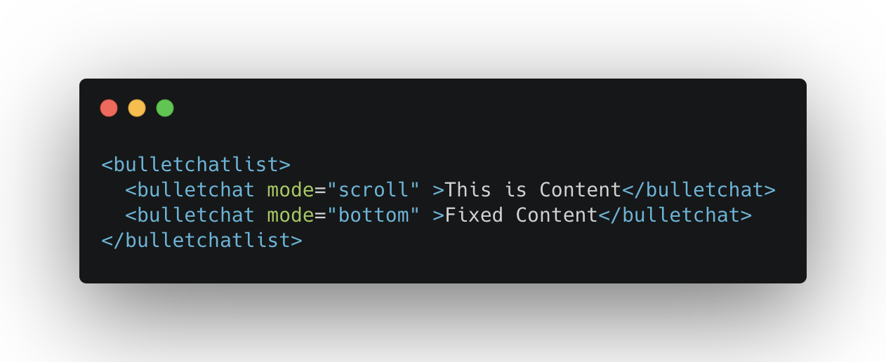
Rendering - UI Component Way
API Proposal
Pros:
- Simple and intuitive
- Better performance
- Flexible, support both video and no-video scenarios
Cons:
- Browser vendors aren't interested in adding new UI component, it may risk security issues
- Lifecycle needs to be handled by developers（removing invisible bullet chatting comments, syncing with the video timeline, etc. ）

Slide 4
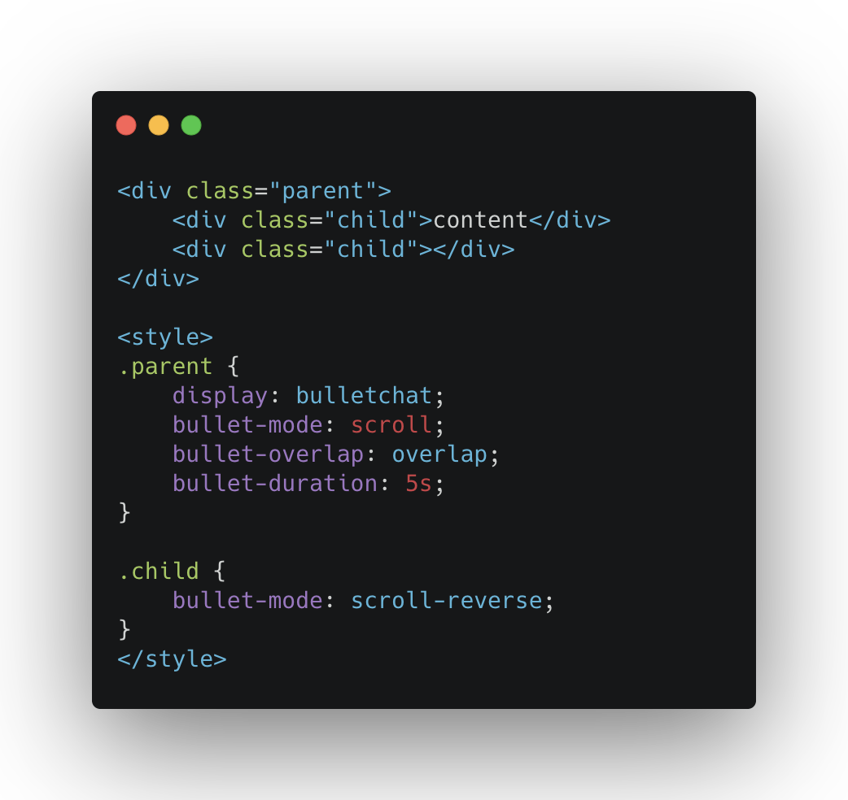
Rendering - CSS Way
Inspired by UI Component Way
Adding new CSS attribute： "display: bulletchat"
Pros:
- Simple and intuitive
- Flexible, support both video and no-video scenarios
- CSS way seems been an appetite for browser vendors
Cons:
- Lifecycle need to be handled by developers（remove invisible bullet chatting comments, syncing with the video timeline, etc .）

Slide 5
Rendering - CSS Way
Parent CSS properties:
- display: bulletchat
- bullet-mode: scroll/fixed-top/fixed-bottom/scroll-reverse, defines the type of Bullet Chatting
- bullet-overlap: normal / overlap, defines whether the Bullet Chatting beyond the display area allows overlap
- bullet-duration: <time>, in seconds (s) or milliseconds (ms), defines the duration of the Bullet Chatting

Slide 6
Rendering - CSS Way
Child CSS properties:
- bullet-mode: scroll/fixed-top/fixed-bottom/scroll-reverse, defines the type of Bullet Chatting
- bullet-play-state: initial/running/paused, defines the state of the Bullet Chatting as running or paused
- bullet-play-delay: <time>, in seconds (s) or milliseconds (ms), defines when the Bullet Chatting animation begins, defining a negative value allows a Bullet Chatting to start moving from the middle.
- bullet-duration: <time>, in seconds (s) or milliseconds (ms), defines the duration of the Bullet Chatting

Slide 7
Next Step
Looking for better CSS attribute naming
More API proposal ?

